Slide 1
PATOLOGIA DIGITAL, INTELIGÊNCIA ARTIFICIAL E NEUROPATOLOGIA
Fernando P. Frassetto
MD, PhD, MBA

Slide 2
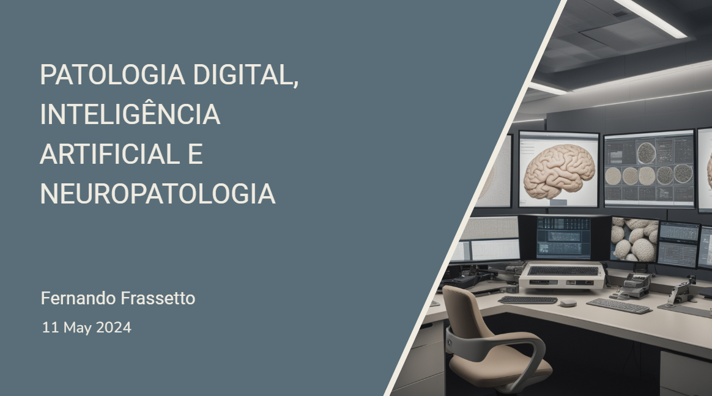
Notes:
Decktopus

Slide 3
Declaração de Conflito de Interesse
Dr. Fernando P. Frassetto afirma não ter conflito de interesse a declarar
Exigência da RDC Nº 96/08 da ANVISA

Slide 4
Agenda
. Introdução
. Conceitos Básicos
. Patologia digital, Inteligência artificial e Neuropatologia
. Perspectivas futuras

Slide 5
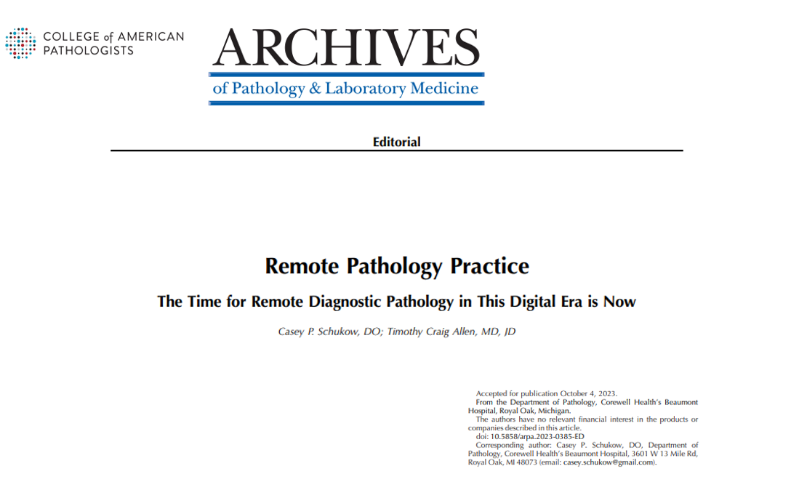

Slide 6
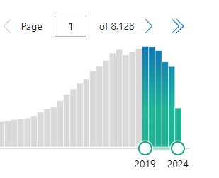
(computational AND pathology) OR (pathology AND artificial intelligence) OR (artificial intelligence AND whole slide image) OR (deep learning AND pathology) OR (deep learning AND whole slide image)
Maio 27, 2024

Slide 7
Introdução
Entender os conceitos é fundamental
Dados/Data
Patologia Digital (DP) e Computacional (CPATH)
Inteligência artificial (AI)
Machine Learning (ML)
Deep Learning (DL)
Neural Networks (NN)

Slide 8
CONCEITOS BÁSICOS

Slide 9
Dados
Data Science
Em computação, Dado (ou Variável) = algo que pode ser representado, armazenado e manipulado
As linguagens de programação (Java, Python, C, PHP) trabalham o tempo inteiro com dados em seus algoritmos
Big data: manipulação, tratamento e análise de quantidades maciças de dados

Slide 10
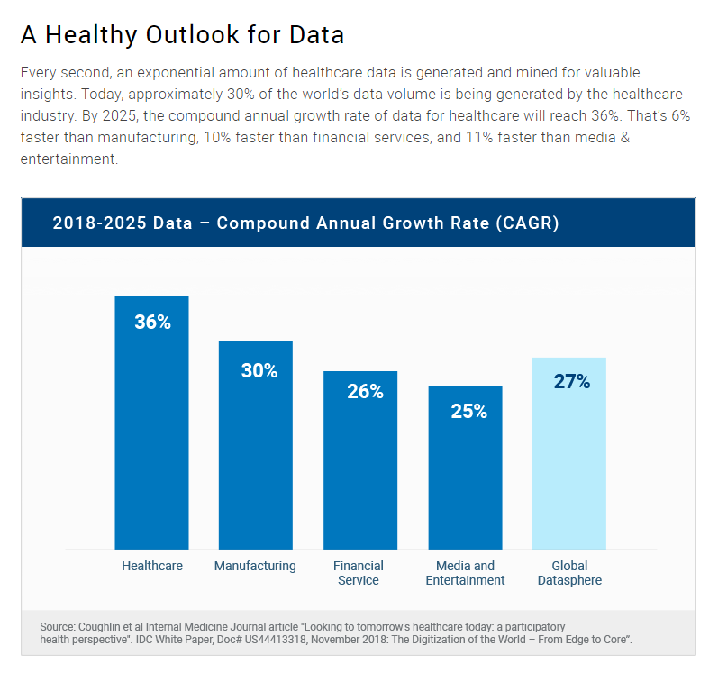
https://www.rbccm.com/en/gib/healthcare/episode/the_healthcare_data_explosion

Slide 11
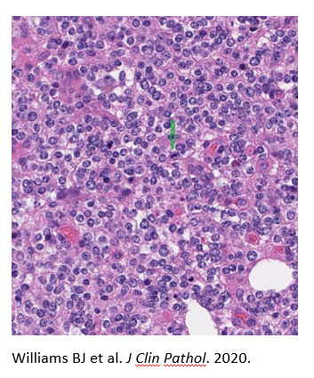
Organização dos Dados
Datasets
Geralmente dados estão “bagunçados”, em vários formatos - necessário estruturar
. Sequências ordenadas (listas, arrays, vetores)
. Tabelas
. Redes e Grafos
. Dados geográficos
. Textos
. Imagens

Slide 12
Patologia Digital (DP)
“Digitização” (digitization): tornar as lâminas de vidro acessíveis em formato digital
Digitalização (digitalization): uso das lâminas digitais para análise (de imagens, por exemplo)
Transformação digital (digital transformation): processo de integração da tecnologia digital em todos os aspectos de uma empresa ou instituição, mudando fundamentalmente a forma como ela opera e entrega valor

Slide 13
CPATH
A branch of pathology that involves computational analysis of a broad array of methods to analyze patient specimens for the study of disease
(Abels E, Pantanowitz L, Aeffner F et al. Computational pathology definitions, best practices, and recommendations for regulatory guidance: a white paper from the Digital Pathology Association. J Pathol. 2019)

Slide 14
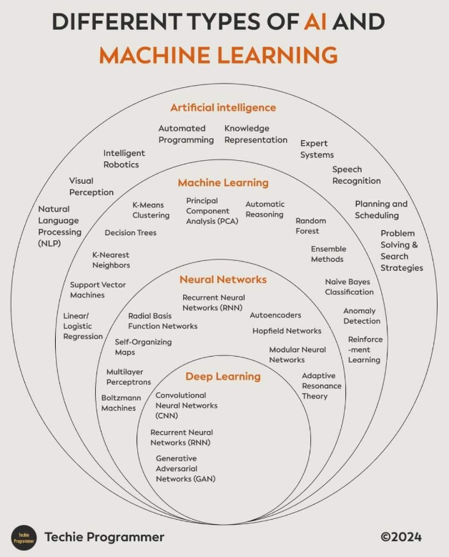
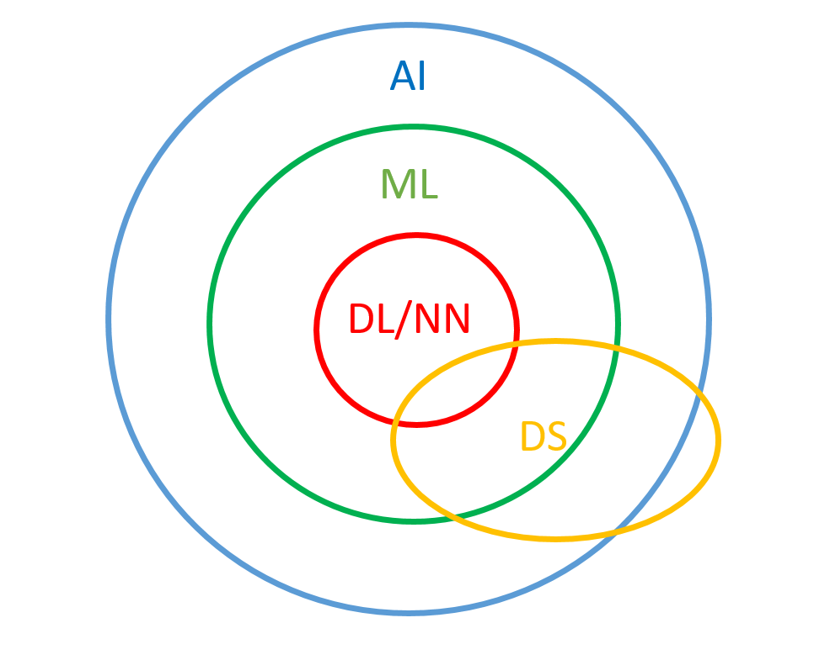

Slide 15
AI
Artificial general intelligence: “tudo que o humano faz” – “AI refers to the simulation of the human mind in computer systems that are programmed to think like humans and mimic their actions such as learning and problem-solving. AI should be able to perform tasks that normally require human intelligence, such as visual perception, decision-making, and communication” (Cui M, Zhang DY. Artificial intelligence and computational pathology. Lab Invest. 2021)
Mas máquinas não “pensam” - utilizam informação para melhorar sua performance (learning rather than thinking), em busca de similaridades/padrões
Moravec´s Paradox (Hans Moravec): tasks that are easy for humans to perform (eg, motor or social skills) are difficult for machines to replicate, whereas tasks that are difficult for humans (eg, performing mathematical calculations or large-scale data analysis) are relatively easy for machines to accomplish

Slide 16
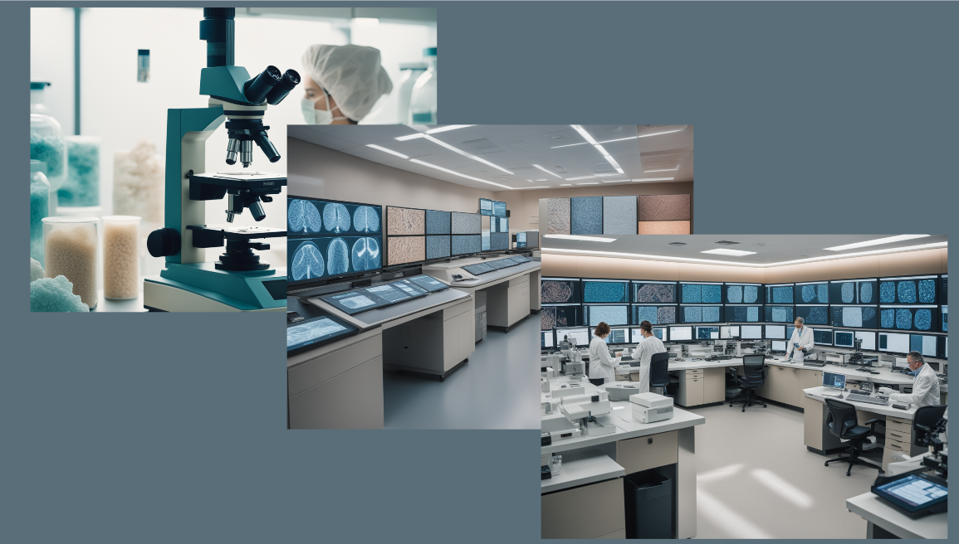

Slide 17
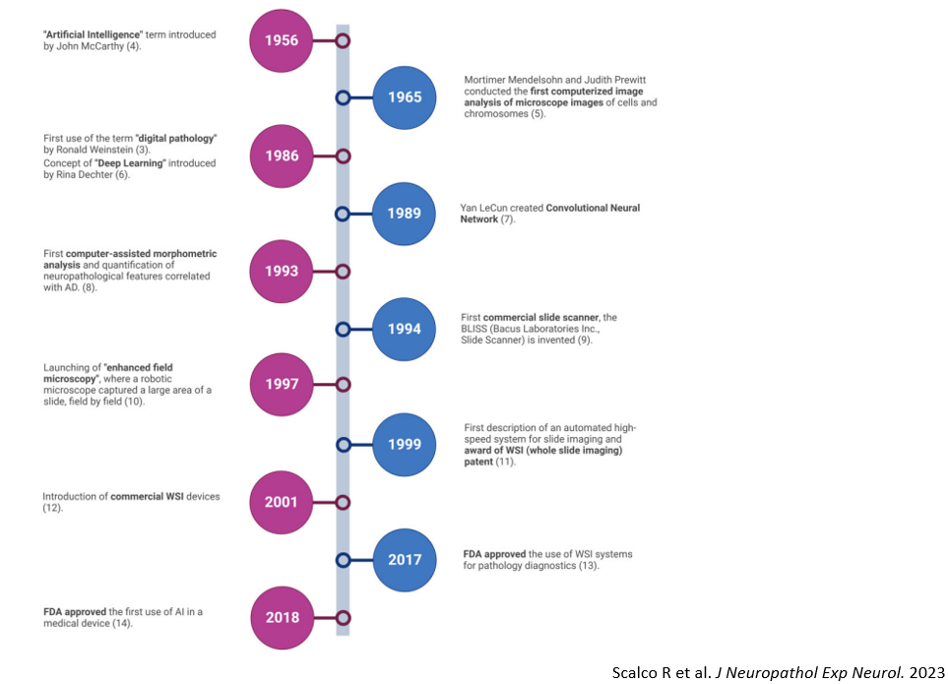
“telepathology”

Slide 18
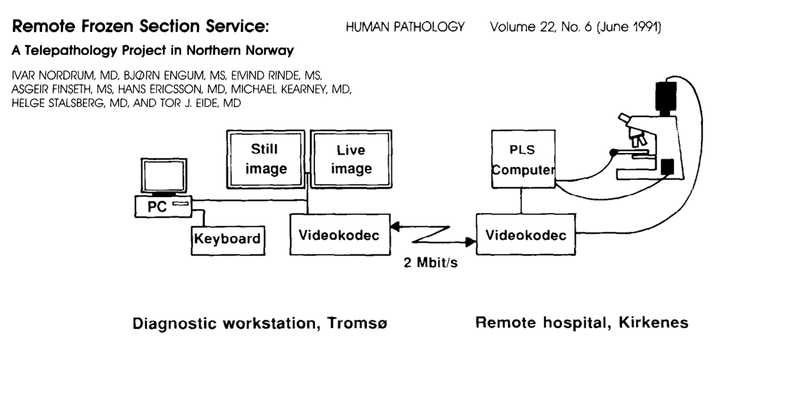

Slide 19
Whole Slide Imaging
Wetzel and Gilbertson, 1999: WSI de alta velocidade - fully automated, high speed device that can image entire slides at high resolution and at a reasonable cost
Imagens de alta resolução, em três eixos e em múltiplas magnificações
Escaneamento relativamente rápido
Imagens pesadas – necessidade de downsampling

Slide 20
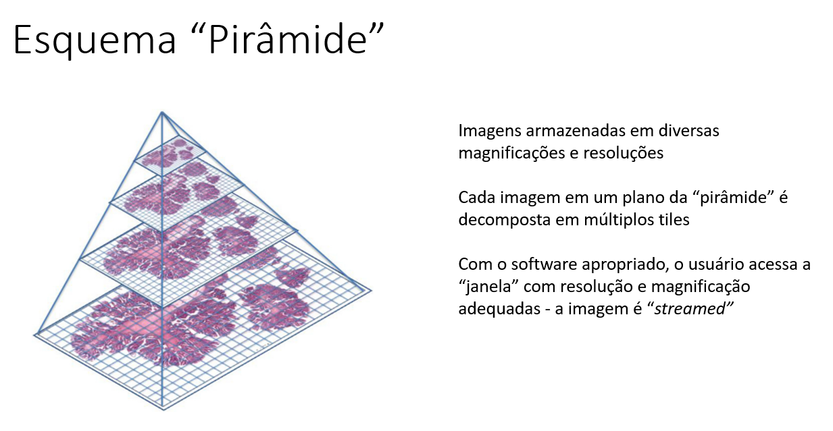
Hamilton PW et al. Digital pathology and image analysis in tissue biomarker research. Methods. 2014

Slide 22
Machine Learning
“Field of study that gives computers the ability to learn without being explicitly programmed” (Arthur Samuel, 1959) – software
Classe de algoritmos computacionais que constroem modelos principalmente para classificação e predição, a partir de dados (atributos/características/features) existentes, resultando em um output específico - simplificadamente, descobrir diferenças e/ou semelhanças, bem como padrões, entre grupos (sets) de coisas quaisquer
O computador aprende conceitos por experiência, usando-a para melhorar sua performance, e não apenas segue um set de instruções explícitas
A habilidade fundamental de qualquer ML é generalizar, ou seja, dar outputs “corretos” a partir de inputs nunca vistos antes

Slide 23
Machine Learning
Todos os tipos de ML necessitam de treinamento
Shallow learning: sem camadas “escondidas”, feature engineering (necessita do programador criando o set de dados)
Deep learning: múltiplas camadas, feature learning (atua “por conta própria” diretamente dos dados)

Slide 24
Treinamento
Exemplos conhecidos - “training set”
Exemplos conhecidos para teste - “validation/test set”, “a máquina aprendeu?”
Tipos de treinamento:
. Supervised Learning
. Unsupervised Learning
. Transfer Learning
. Reinforcement Learning

Slide 25
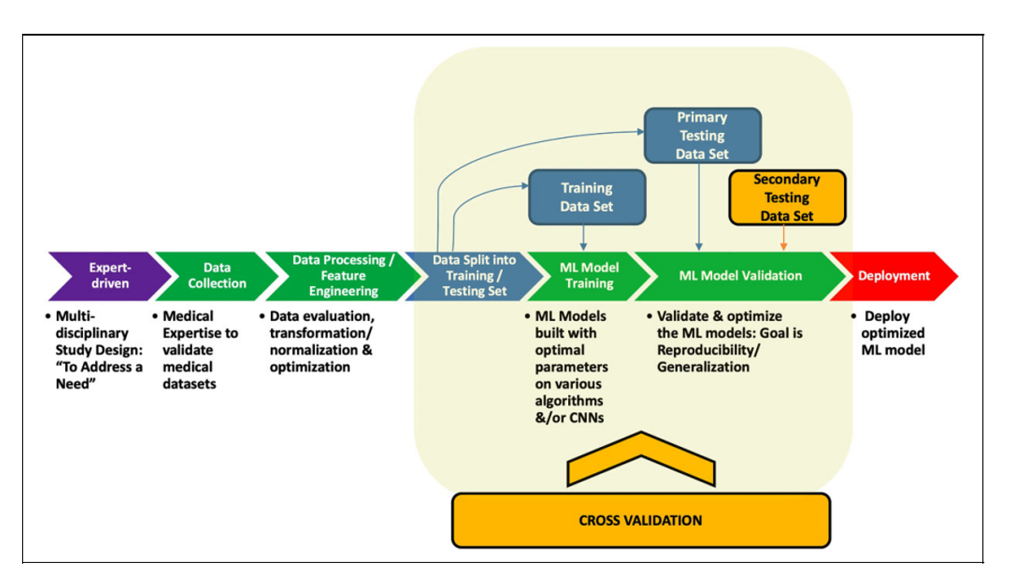
Rashidi HH et al. Artificial Intelligence and Machine Learning in Pathology: The Present Landscape of Supervised Methods. Acad Pathol. 2019

Slide 26
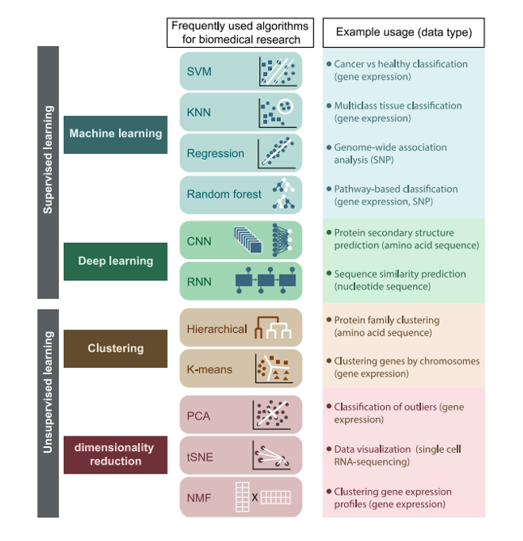
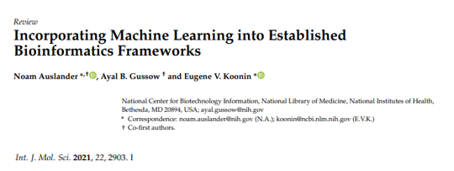

Slide 27
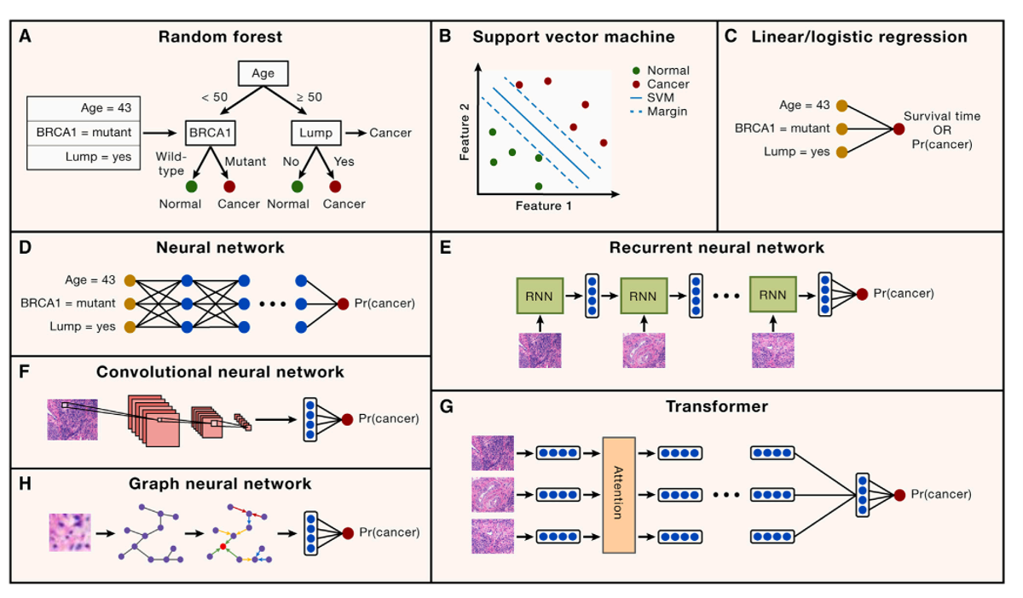
Swanson K et al. From patterns to patients: Advances in clinical machine learning for cancer diagnosis, prognosis, and treatment. Cell. 2023
Notes:
Acurácia E a G

Slide 29
(Artificial) Neural Networks
Construção em multicamadas (multi-layered) - Deep learning; maior número de camadas, maior complexidade de tarefas
Estrutura baseada vagamente no funcionamento do SNC, que é muito complexo

Slide 30
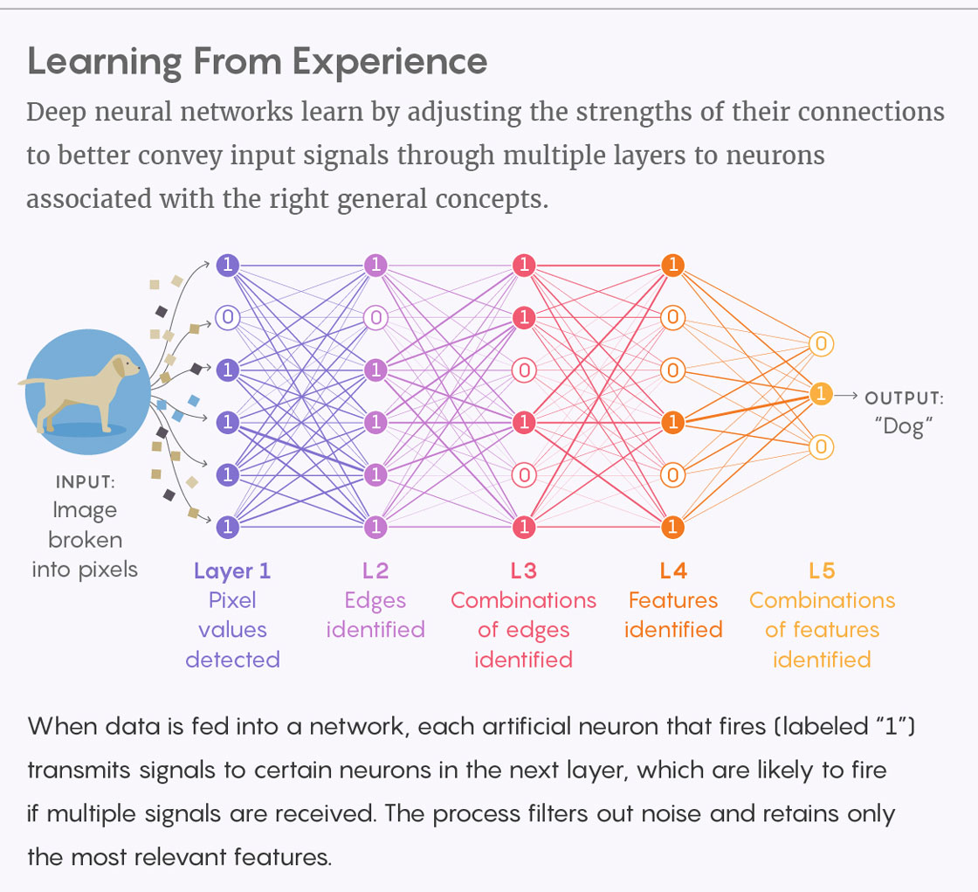
Lucy Reading-Ikkanda/Quanta Magazine
Notes:
Combinações de dados contidas no input →
Representações internas de dados do sistema não diretamente acessíveis ao observador/programador (“black box”, “hidden layers”) - a máquina “abstrai” por conta própria (“own-rules”) as combinações de dados → Output
O sistema refina com o tempo as representações de dados (aprende), aperfeiçoando o decision-making

Slide 31
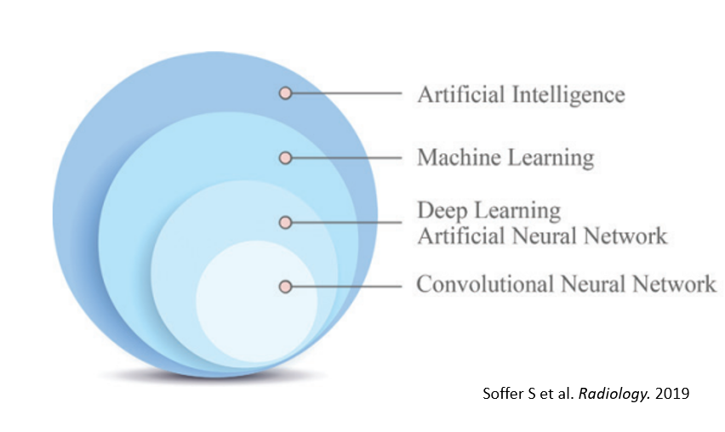
Convolutional Neural Networks
Superior para análise de imagens – “assume” que os inputs são imagens
Estrutura vagamente similar à do córtex visual - neurônios respondendo a estímulos de apenas uma pequena parte (campo receptivo) do campo visual, mas sobreposição de áreas permitindo a identificação de todo o campo

Slide 32
https://thepathologist.com/inside-the-lab/learning-the-language

Slide 33
(algumas) Limitações
Necessidade de grande quantidade de dado para treinamento (“data hungry”)
Dificuldade em entender os mecanismos preditivos (“black box”)

Slide 34
DP, AI e NEUROPATOLOGIA

Slide 35
DP, AI e Neuropatologia
Doenças neurodegenerativas
Neuro-oncologia
Exames intraoperatórios
Spatialomics

Slide 36
DP, AI e Neuropatologia
An approach tailored to neuropathology would require (1) careful delineation of the machine learning task; (2) construction of a curated image dataset with high-resolution annotations by experts; and (3) extensive model interpretability
(….) Reliable, scalable, and interpretable measures (…)
(Tang Z et al. Interpretable classification of Alzheimer's disease pathologies with a convolutional neural network pipeline. Nat Commun. 2019)
Mas antes um problema prático...Figuras de mitose.

Slide 37
In this CNS volume, therefore, where possible, mitotic counts have been expressed as the number of mitoses per a defined area in mm², as well as per the commonly used denominator of 10 HPF.
As an example, the discussion on diagnosis of atypical meningiomas specifies “≥ 2.5 mitoses per mm² (4 mitoses per 10 consecutive 0.16 mm² fields)”. Therefore, a diagnosis of atypical meningioma based on mitotic count requires the finding of ≥ 4 mitoses within a 1.6 mm² area. If, for instance, one’s ocular or digital field dimensions are > 0.16 mm², then the conversion could come out to only 7 or 8 consecutive high-power fields rather than 10.

Slide 38
HPF e DP
Muitas variáveis afetando o que é um HPF
Scanner e sistema computacional, image (slide) viewer, monitor – muitos parâmetros a serem considerados:
. Scanner (fabricante, modelo) e sua resolução
. Slide viewer (fabricante, modelo)
. Monitores (fabricante, modelo, diâmetro de tela), sua resolução e aspect ratio (relação largura-altura; 16:9, p. ex.)
. Sistema computacional (processador, memória RAM)

Slide 39
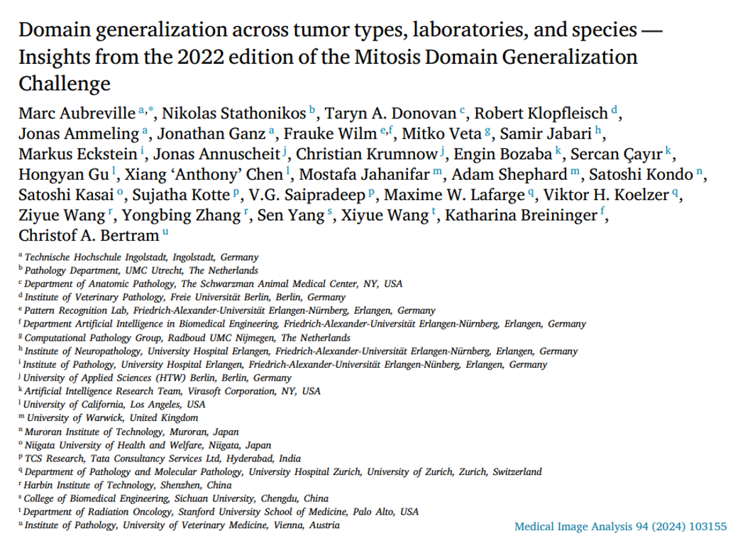

Slide 40
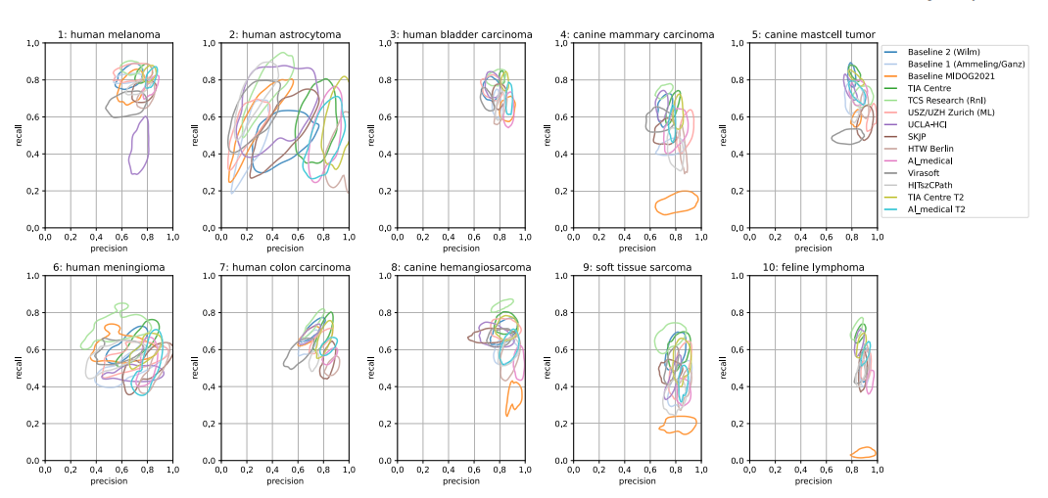
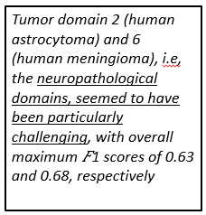
Aubreville M et al. Med Image Anal. 2024

Slide 41
DP, AI e Neuropatologia
Múltiplos (potenciais e “reais”) usos
. Diagnóstico
. Prognóstico
. Predição
. Estabelecimento de escores
. Identificação e quantificação de biomarcadores
. Colaborações e data sharing
. Identificação de alvos terapêuticos, desenvolvimento de drogas

Slide 42
DP, AI e Neuropatologia
Mas...
. Tamanho variável das amostras
. Protocolos de processamento dos espécimes muito diversos – coloração, p. ex.
. Heterogeneidade de training sets
. Artefatos em amostras
. Heterogeneidade das áreas de lesão
. Etc.

Slide 43
Doença de Alzheimer
Avaliação histopatológica como gold standard
Escores baseados em avaliação semiquantitiva dos achados característicos
Grande variação interobservador, consumo de tempo – necessidade de restringir avaliação a número limitado de áreas e estruturas (também geralmente necessário à avaliação por software)

Slide 44
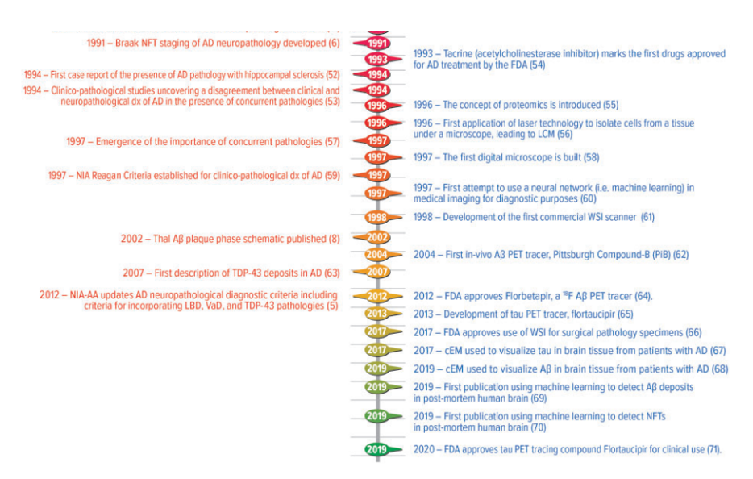
“deeper phenotyping”
Shakir MN, Dugger BN. Advances in Deep Neuropathological Phenotyping of Alzheimer Disease: Past, Present, and Future. J Neuropathol Exp Neurol. 2022

Slide 45
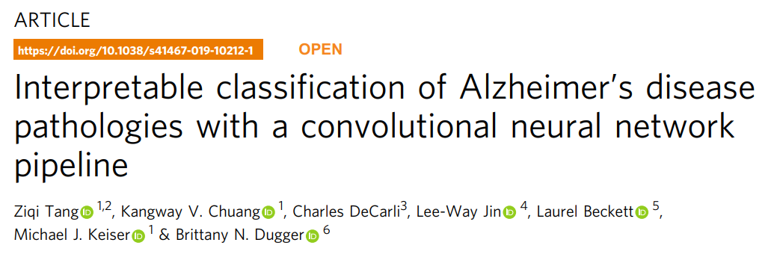
(…) proof-of-concept deep learning pipeline that identifies specific neuropathologies—amyloid plaques and cerebral amyloid angiopathy—in immunohistochemically-stained archival slides
CNNs automatically learn relevant features from immunohistochemical image data and to exploit Alzheimer’s disease pathological features in agreement with human-interpretable neuropathology
CNN-based Aβ pathology burden agrees with CERAD-like scoring

Slide 46
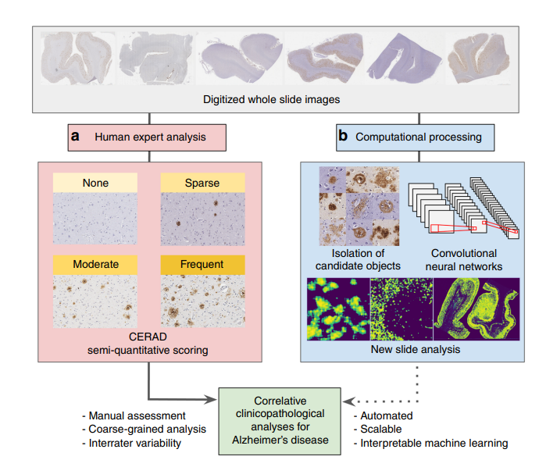
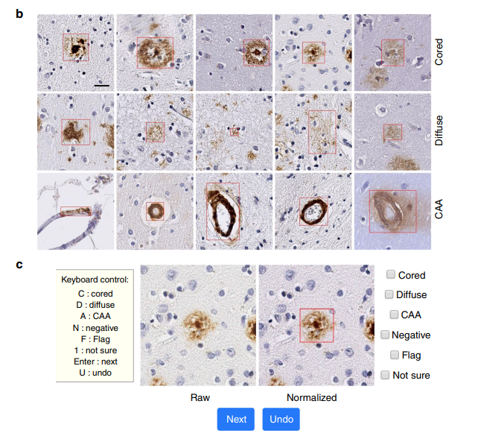
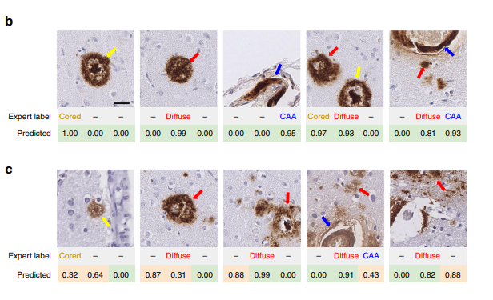
Predições “corretas” (confidence score ≥0.8)
Predições “corretas” e “incorretas”
Tang Z et al. Nat Commun. 2019
Notes:
1 - Pipeline; Abeta IHC
2 – Treinamento
3 - confidence scores ≥0.8
b Examples of correct CNN predictions. The ground truth expert label row indicates the pathologies that had been manually found within the tile image. The predicted row shows corresponding model confidences for cored plaque (yellow arrow), diffuse plaque (red), and CAA (blue) classes (from left to right). Model predictions range from 0.00 to 1.00, where a higher score indicates higher predicted confidence by the CNN for that plaque class (e.g., the 1.00 corresponds to 100% model confidence that a cored plaque is present in the leftmost panel). c Examples of CNN predictions that do not agree with the expert manual annotation. Incorrect model predictions are indicated by light orange backgrounds in the predicted column; green backgrounds correspond to correct predictions 0.8

Slide 47
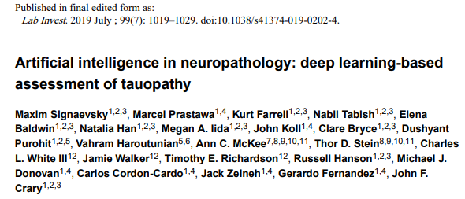
(...) to develop and test a novel DL algorithm using convolutional neural networks that would be able to recognize, classify, and quantify diagnostic elements of tauopathies (NFTs) on WSI of postmortem human brain tissue specimens from patients with tau-associated neurodegenerative conditions

Slide 48
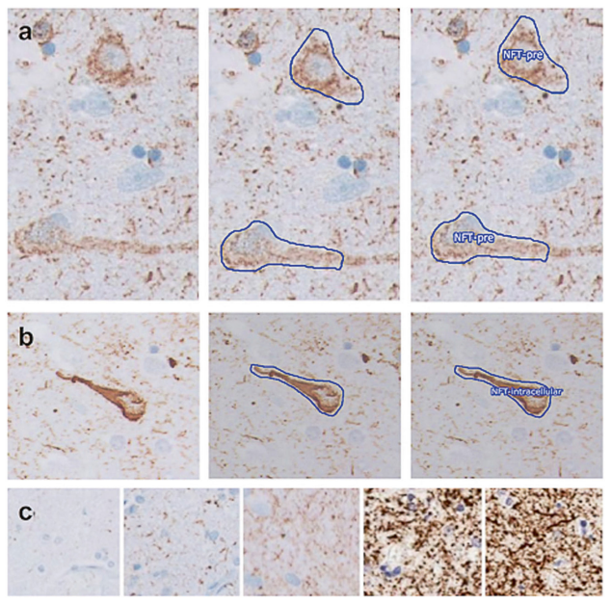
AT8
Signaevsky M et al. Lab Invest. 2019
Notes:
Expert annotation of whole slide images for ground truth ascertainment. a, b Examples of the stepwise process of annotation and assignment of a classifier for a pre-tangle and a mature NFT, respectively. Panels on the left show a naive image, middle panels show the manual outlining performed by an expert, and right panels show the assignment of classifiers

Slide 49
Signaevsky M et al. 2019
The network achieves high sensitivity for both validation and test data, with a lower precision on the test set compared to the validation set
Our NFT classifier currently takes an average of 45 min to 1h to computationally identify and count NFT on an entire WSI, illustrating the feasibility of applying this approach to large datasets
Notes:
Primary age-related tauopathy (PART)
progressive supranuclear palsy (PSP)
chronic traumatic encephalopathy (CTE)

Slide 50
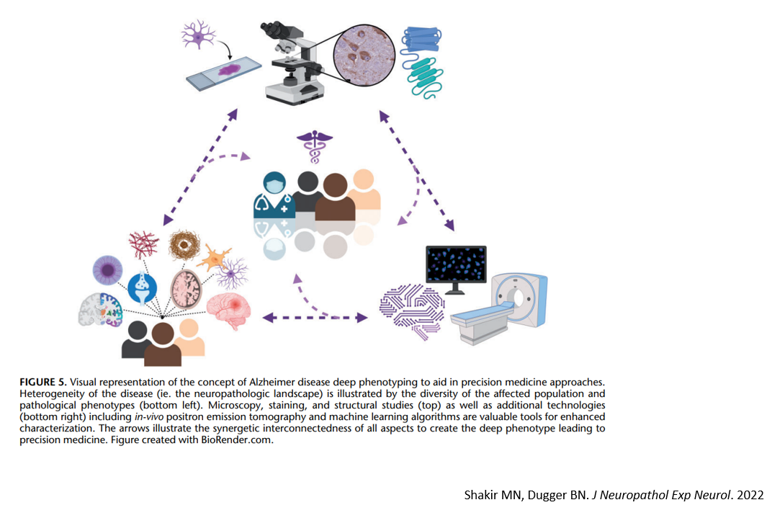
MEDICINA DE PRECISÃO

Slide 51
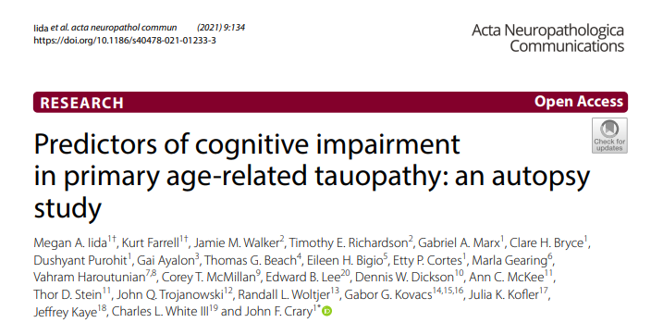
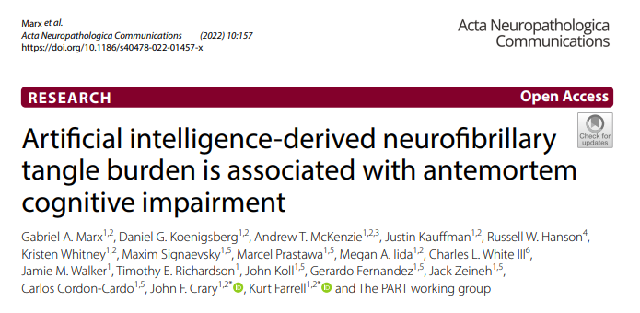
Outros papers muito interessantes...

Slide 52
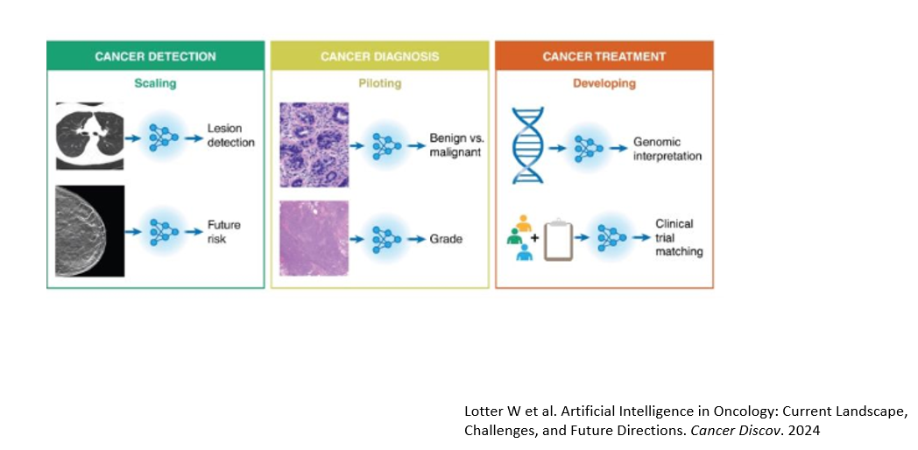
Neuro-oncologia

Slide 53
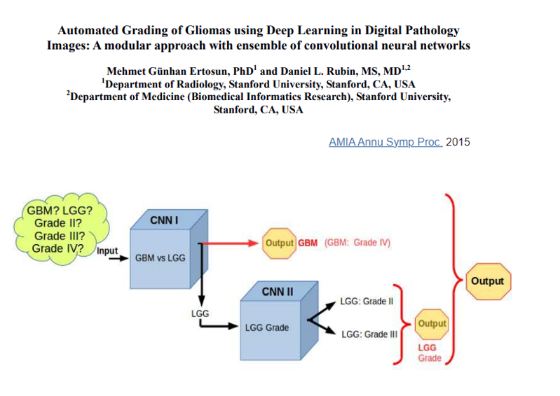
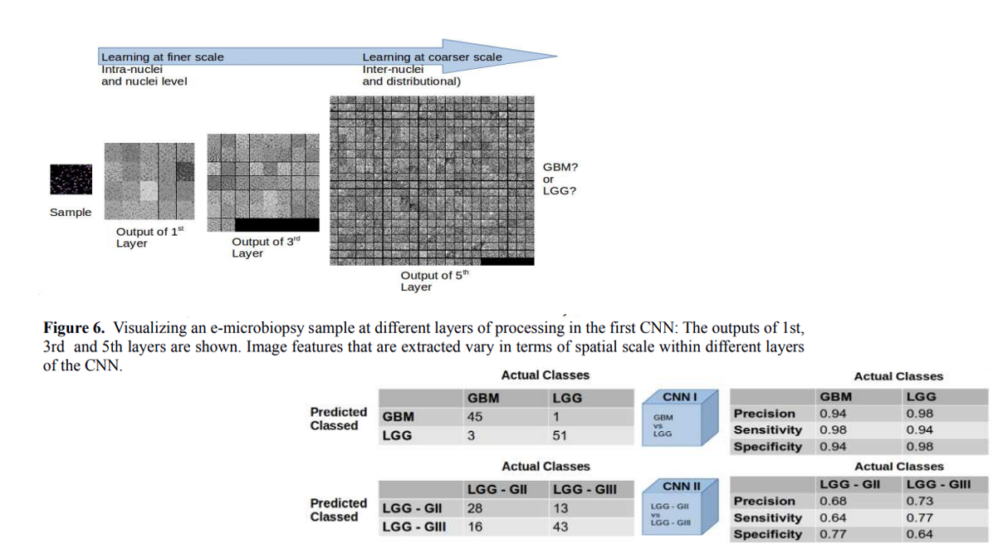

Slide 54
Survival convolutional neural networks (SCNNs): predição de eventos a partir de características morfológicas de gliomas difusos
Integração com biomarcadores (Genomic SCNNs) – IDH, 1p/19q

Slide 55
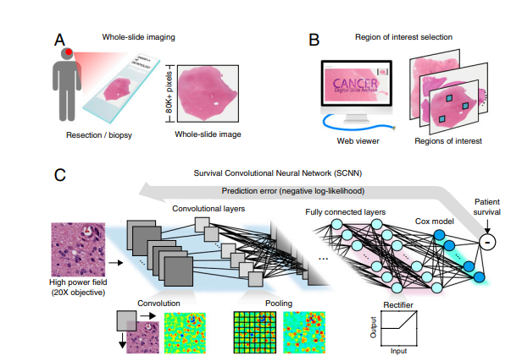
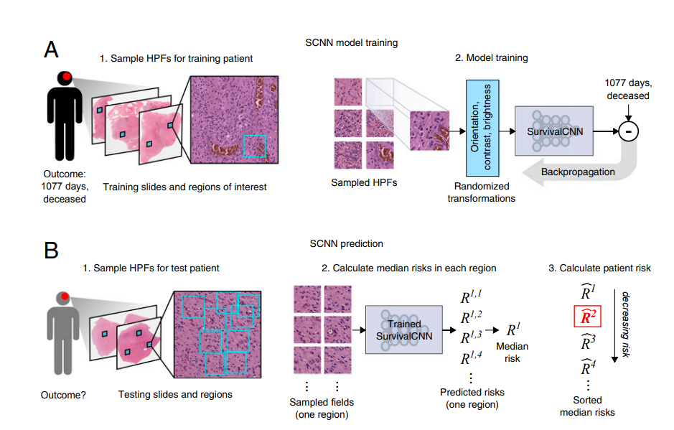
Mobadersany P et al. Proc Natl Acad Sci U S A. 2018
Notes:
1 - The SCNN combines deep learning CNNs with traditional survival models to learn survival-related patterns from histology images. (A) Large whole-slide images are generated by digitizing H&E-stained glass slides. (B) A web-based viewer is used to manually identify representative ROIs in the image. (C) HPFs are sampled from these regions and used to train a neural network to predict patient survival. The SCNN consists of (i) convolutional layers that learn visual patterns related to survival using convolution and pooling operations, (ii) fully connected layers that provide additional nonlinear transformations of extracted image features, and (iii) a Cox proportional hazards layer that models time-to-event data, like overall survival or time to progression. Predictions are compared with patient outcomes to adaptively train the network weights that interconnect the layer
2 - SCNN uses image sampling and filtering to improve the robustness of training and prediction. (A) During training, a single 256 × 256-pixel HPF is sampled from each region, producing multiple HPFs per patient. Each HPF is subjected to a series of random transformations and is then used as an independent sample to update the network weights. New HPFs are sampled at each training epoch (one training pass through all patients). (B) When predicting the outcome of a newly diagnosed patient, nine HPFs are sampled from each ROI, and a risk is predicted for each field. The median HPF risk is calculated in each region, these median risks are then sorted, and the second highest value is selected as the patient risk. This sampling and filtering framework was designed to deal with tissue heterogeneity by emulating manual histologic evaluation, where prognostication is typically based on the most malignant region observed within a heterogeneous sample. Predictions based on the highest risk and the second highest risk had equal performance on average in our experiments, but the maximum risk produced some outliers with poor prediction accuracy

Slide 56
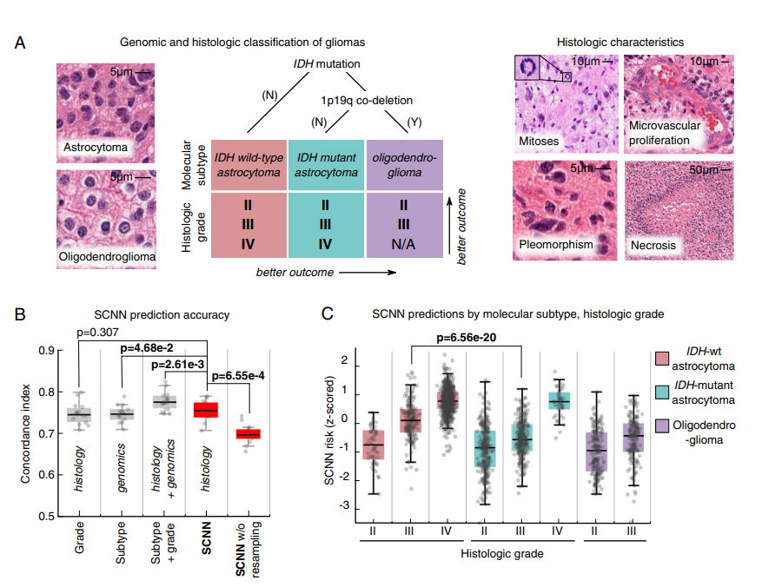
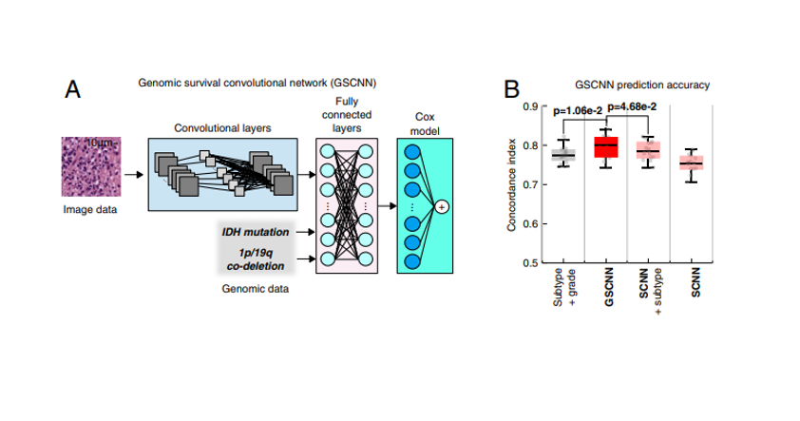
SCNN performed as well as manual histologic grading or molecular subtyping in predicting overall survival
(…) SCNN can effectively discriminate outcomes within each molecular subtype, effectively performing digital histologic grading
The GSCNN models significantly outperform SCNN models as well as the WHO paradigm based on genomic subtype and histologic grading.
Mobadersany P et al. Proc Natl Acad Sci U S A. 2018
Notes:
SCNN models showed substantial prognostic power, achieving a median c index of 0.754 (Fig. 3B). SCNN models also performed comparably with manual histologic-grade baseline models (median c index 0.745, P = 0.307) and with molecular subtype baseline models (median c index 0.746, P = 4.68e-2). Baseline models representing WHO classification that integrate both molecular subtype and manual histologic grade performed slightly better than SCNN, with a median c index of 0.774 (Wilcoxon signed rank P = 2.61e-3).
We also evaluated the impact of the sampling and ranking procedures shown in Fig. 2 in improving the performance of SCNN models. Repeating the SCNN experiments without these sampling techniques reduced the median c index of SCNN models to 0.696, significantly worse than for models where sampling was used (P = 6.55e-4).
we visualized how risks predicted by SCNN are distributed across molecular subtype and histologic grade (Fig. 3C). SCNN predictions were highly correlated with both molecular subtype and grade and were consistent with expected patient outcomes
The GSCNN learns from genomics and histology simultaneously by incorporating genomic data into the fully connected layers of the SCNN
GSCNN models integrate genomic and imaging data for improved performance. (A) A hybrid architecture was developed to combine histology image and genomic data to make integrated predictions of patient survival. These models incorporate genomic variables as inputs to their fully connected layers. Here, we show the incorporation of genomic variables for gliomas; however, any number of genomic or proteomic measurements can be similarly used. (B) The GSCNN models significantly outperform SCNN models as well as the WHO paradigm based on genomic subtype and histologic grading.

Slide 57
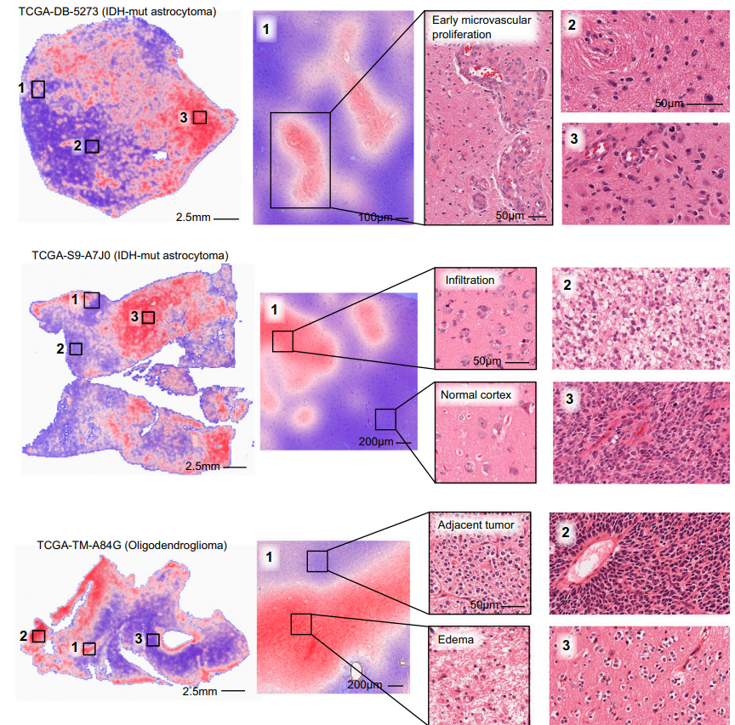
Heat map analysis provides insights into the histologic patterns associated with increased risk and can also serve as a practical tool to guide pathologists to tissue regions associated with worse prognosis.
SCNN also assigned high risks to regions that do not contain well-recognized features associated with a higher grade or poor prognosis (…) assigns higher risk to sparsely infiltrated cerebral cortex than to region (…) which is infiltrated by a higher density of tumor cells
(…) high risk associated with low-cellularity edematous regions compared with adjacent oligodendroglioma with much higher cellularity. Edema is frequently observed within gliomas and in adjacent brain (…) but its histologic presence has not been previously recognized as a feature of aggressive behavior or incorporated into grading paradigms
Mobadersany P et al. Proc Natl Acad Sci U S A. 2018

Slide 58
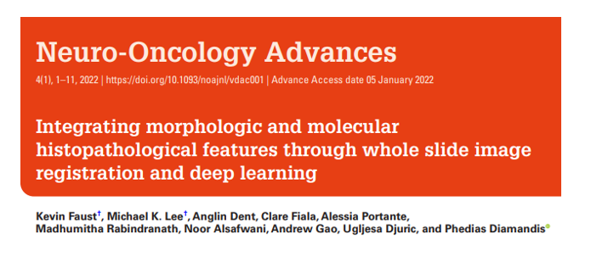
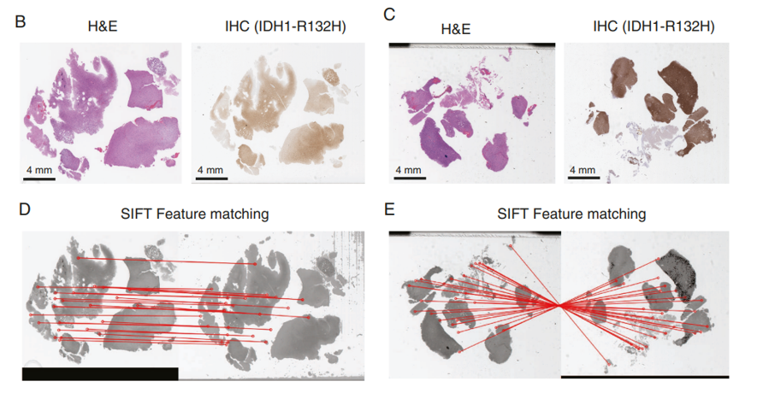
Notes:
2 - To overcome size and colorization barriers to image registration, our workfow carries out bicubic resizing of WSIs into small thumbnail-like images (~100 × reduction in size) and normalize pixel intensity distribution of the respective IHC through histogram matching, to mirror that of the H&E image (Figure 1b–e, Supplementary Fig 1). On these resulting images, we use SIFT (scale invariant feature transform) to find features for image matching and filter “good matches” using Lowe’s ratio test. The resulting matches are used to generate a homography, mapping points from one image to another, using random sample consensus
The scale-invariant feature transform (SIFT) is a computer vision algorithm to detect, describe, and match local features in images, invented in 1999
To perform reliable recognition, it is important that the features extracted from the training image be detectable even under changes in image scale, noise and illumination. Such points usually lie on high-contrast regions of the image, such as object edges
3 - Numerous SIFT feature matchings (red lines) highlight good alignment despite these rotations/shifts.

Slide 59
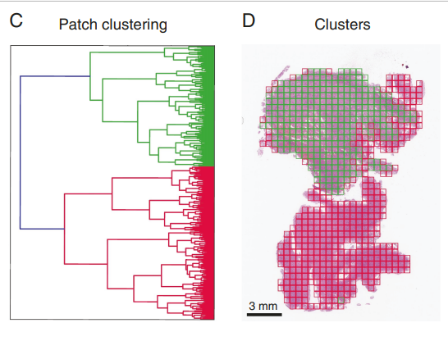
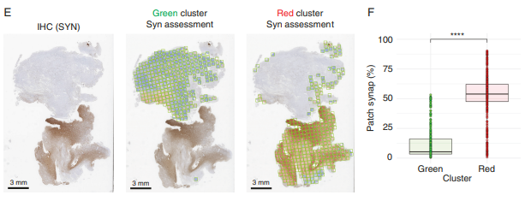
Faust K et al. Neurooncol Adv. 2022
Notes:
Unsupervised analysis of image patch-level tissue patterns highlighted two major histomorphologic clusters (k = 2 agglomerative hierarchical clustering, silhouette score) (Figure 3c and d). Despite these regions initially appearing as cellular tumor areas on H&E, one subregion, following alignment with the synaptophysin IHC, could be better defned to represent an infltrative tumor component (Synaptophysin positivity: 52% vs. 13% (red vs. green clusters), P-value = 2.2 × 10−16; Figure 3e and f). This approach could therefore serve to automate objective selection of highly pure area of tumor of expressed-based molecular analysis or explore the heterogenous expression of specifc tumor markers across different tumor niches

Slide 60
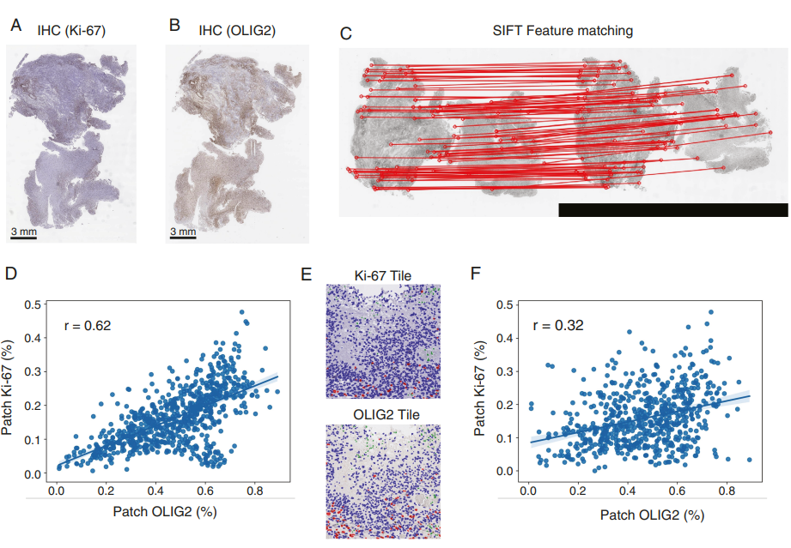
(…) aligning mask R-CNN-based estimates of the proliferation marker Ki-67/MIB1 in each image patch with the values of Olig2 (…) this observation could have important implications for emerging clinical trials using Olig2 inhibitors, as it suggests this class of compounds may not effectively reach slowly dividing/quiescent tumor cells that already elude traditional treatment approaches. Together, these analyses highlight how this WSI alignment approach can also serve as a discovery tool (…)
Faust K et al. Neurooncol Adv. 2022

Slide 61
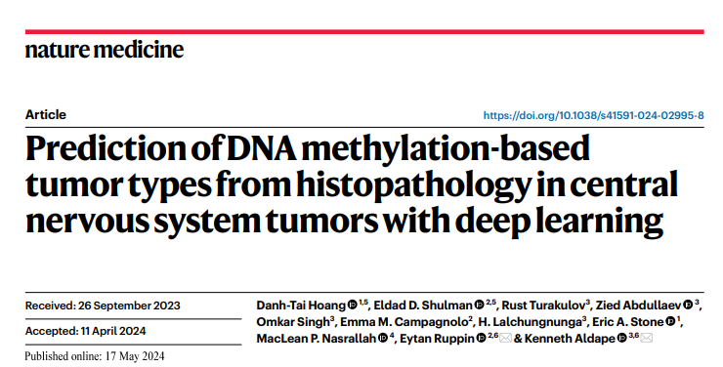
Deep lEarning from histoPathoLOgy and methYlation (DEPLOY): deep learning model that classifies CNS tumors to ten major categories from histopathology
DEPLOY leverages insights gained by DNA methylation profiling for CNS tumor diagnostics, without itself requiring methylation profiling to be performed, therefore bypassing the limitations, potentially offering a low-cost alternative

Slide 62
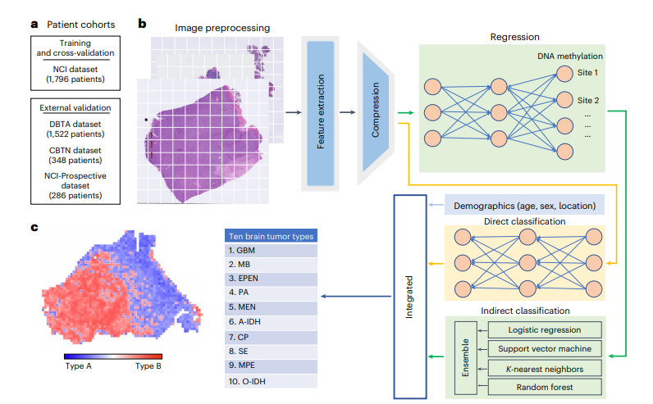
Predição dos tipos de tumores a partir dos slides – “direct”
Classificação dos tumores a partir da predição de suas classes de metilação – “indirect”
Integração dos dados e predição do tipo de tumor
Hoang DT et al. Nat Med. 2024

Slide 63
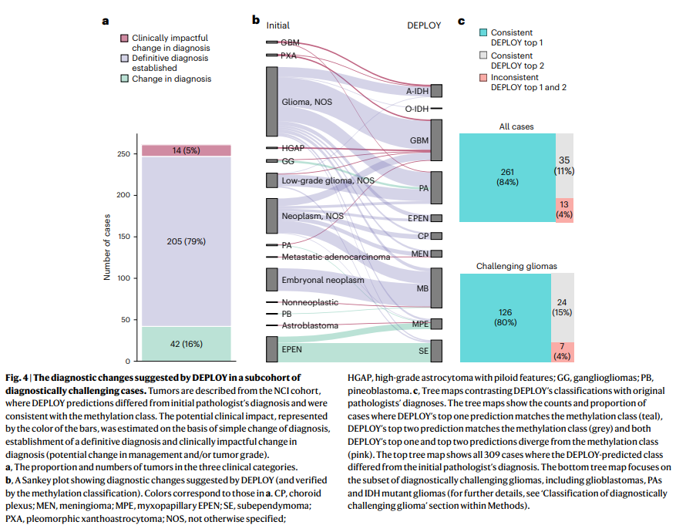
Hoang DT et al. Nat Med. 2024
Notes:
e, Top one and top two class accuracies for tumors with high prediction score matches (>0.39) for the NCI (n = 1,193 patients), DBTA (n = 1,026 patients), CBTN (n = 212 patients) and NCI– Prospective (n = 169 patients) are shown. For every cohort, the top one and top two accuracies of the integrated model are significantly higher than those of each individual component

Slide 64
Exame Intraoperatório
Referenciar caso em tempo real para especialista – ganho de tempo e de qualidade
Redução da necessidade de patologista no local
Capacidade de obter mais dados do que o habitual
Métodos não destrutivos

Slide 65
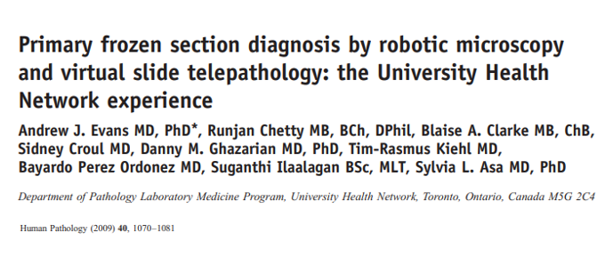
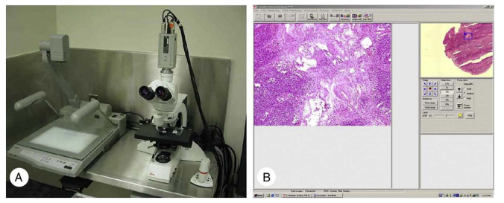
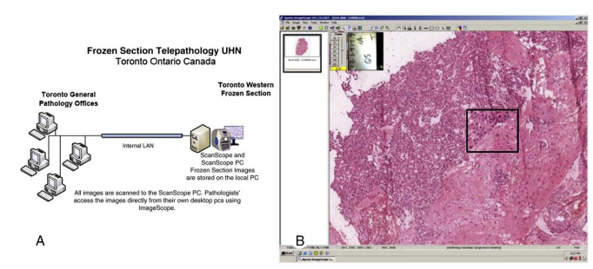
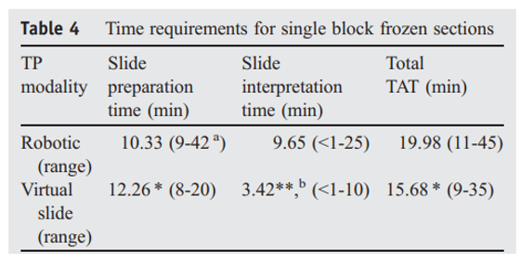

Slide 66
4 classes mutuamente exclusivas: exact, essentially concordant (ex. “glioma + grade deferred”, “diagnostic material present”), discrepant, defer
Notes:
* = < 0.05

Slide 67
Horbinski C t al . J Neuropathol Exp Neurol. 2007
Notes:
Inexact Type
deferred on glioma grade
correctly identified lesion as neoplastic versus nonneoplastic but could not specify the class of the lesion (e.g. “neoplasm” but not “meningioma”
narrowed the differential down to 2 or 3 diagnoses but could not commit to one (e.g. “schwannoma” vs “neurofibroma”)
identified biopsied tissue as abnormal and diagnostic but could not be more specific

Slide 68
Notes:
by using a Raman spectrometer, you can see that often a very tiny fraction of the scattered light has a different colour. It has changed frequency because, during the scattering process, its energy changed by interacting with molecular vibrations. This is the Raman scattering process, named after its discoverer, the famous Indian physicist C.V. Raman.
By studying the vibration of the atoms we can discover the chemical composition and other useful information about the material.

Slide 69
Orringer DA et al. 2017
SRS - stimulated optical imaging method that provides rapid, label-free, sub-micron resolution, images of unprocessed biological tissues
Stimulated Raman Histology - Method for SRS image processing that simulates hematoxylin and eosin (H&E) staining
SRH utilizes the intrinsic vibrational properties of lipids, proteins, nucleic acids to generate image contrast, revealing diagnostic microscopic features and histologic findings poorly visualized with H&E images, such as axons and lipid droplets, while eliminating the artifacts inherent in frozen or smear tissue preparations

Slide 70
Orringer DA et al. Nat Biomed Eng. 2017
Notes:
A) CH2 and (B) CH3 images are acquired and (C) subtracted. (D) The CH2 image is assigned to the green channel, and CH3-CH2 image is assigned to the blue channel to create a two-color blue-green image. Applying an H&E lookup table, SRH images (E) are comparable to a similar section of tumor (F) imaged after FFPE, and H&E staining. (G) Mosaic tiled image of several SRH FOVs to create a mosaic of imaged tissue. Asterisk (*) indicates a focus of microvascular proliferation, dashed circle indicates calcification, and the dashed box demonstrates how the FOV in (E) fits into the larger mosaic. [CH2 = lipids, CH3 = protein];

Slide 71
Orringer DA et al. 2017
In a simulation of intraoperative pathologic consultation in 30 patients, we found a remarkable concordance of SRH and conventional histology for predicting diagnosis (κ > 0.89), with accuracy exceeding 92%
With SRH, the pathologists were highly accurate in distinguishing lesional from non-lesional tissues (98%), glial from non-glial tumors (100%), and predicting diagnosis (92.2%)
Machine learning (multilayer perceptrom - MLP): Based on modal diagnosis (lesion, LG glial, HG glial, non-glial), the MLP accurately differentiated lesional from non-lesional specimens with 100% accuracy. Additionally, the diagnostic capacity of the MLP for classifying individual FOVs as lesional or non-lesional was excellent, with 94.1% specificity and 94.5% sensitivity (…) Among lesional specimens, the MLP differentiated glial from non-glial specimens with 90% accuracy at the sample level
Notes:
FOV = field of view

Slide 72
(…) using only SRH images as input, DeepGlioma can predict the genetic mutations that define the WHO classification of adult-type diffuse gliomas within minutes of tumor biopsy without the need for any tissue processing or conventional pathology laboratory infrastructure (…) detecting canonical and noncanonical IDH mutations with an accuracy of 94.2%. DeepGlioma also predicted 1p19q-codeletion and ATRX mutations without the need for fluorescence in-situ hybridization or genetic sequencing enabling molecular subtyping of diffuse gliomas according to the WHO classification scheme with an accuracy of 91.5%.

Slide 73
Our CHARM models successfully identified malignant cells, distinguished isocitrate dehydrogenase (IDH)-mutant tumors from wild type, classified three major types of molecularly defined gliomas, and identified the most prevalent subtypes of IDH-mutant tumors. CHARM further predicts clinically important genetic alterations in low-grade glioma, including ATRX, TP53, and CIC mutations, CDKN2A/B homozygous deletion, and 1p/19q codeletion via cryosection images

Slide 75
Vermeulen C et al. 2023
Intraoperative methylation-aware nanopore sequencing for CNS tumour classification
Sturgeon (neural network classifier): deep learning approach that is trained on simulated nanopore sequencing data generated from readily available methylation array data and can accurately classify tumour types based on intraoperatively generated sequence data.
The model was able to correctly classify the vast majority of samples (45 out of 50) based on data equivalent to 20–40 min of sequencing, in line with a 90-min time window between obtaining tissue in the operating room and diagnosis (…) turnaround times of 1.5 h are feasible for the majority of samples. This is fully compatible with the surgical timeline, to guide the surgeon on how to proceed with the procedure.
We envision clinical application of Sturgeon to be deployed in parallel to histological assessment by a trained pathologist, who then integrates the histological and molecular results into an improved intraoperative diagnosis

Slide 76
Vermeulen C et al. Nature. 2023
Notes:
Performance of Sturgeon on the four test folds of the Capper et al. dataset (added up for the four submodels). F1 scores for each reference label at 40 min of simulated sequencing (approximately 97% missing values compared with microarray data). Solid bars indicate the F1 score for the highest-scoring class and transparent bars show the F1 score for the top three highest-scoring classes.
We decided to conservatively use a cut-off score of 0.95 to confidently classify a sample. Using this cut-off, 80 out of the 91 classes in the test set have a true positive rate (TPR) higher than 0.95
we performed the protocol during 25 surgeries
2
Sturgeon was able to correctly classify 72% of tumours (18 out of 25) at the subclass level with at most 45 min of sequencing
. We encountered several cases where a rapid molecular classification would have been of substantial added value. For example, in cases INTRA_23 and INTRA_25, the tumour class was not known prior to surgery
Top bar indicates the sample name. Circles indicate the predicted score of the correct class; diamonds indicate the predicted score of incorrect classes (classes with overtime averaged scores lower than 0.1 are omitted). Asterisks indicate the first time point where the score of the correct class was higher than 0.95. Horizontal line indicates the 0.95 threshold
3 Using a downsampling approach, we were able to detect large scale CNVs such as the chromosome 1p deletion from as few as 20,000–50,000 sequence reads, although smaller CNVs such as the chromosome 19q deletion are less reliably detected (…) we therefore follow the example of the Heidelberg classifier: we provide CNV plots in our workflow to the pathologist in parallel with the methylation classifier result for further interpretation”

Slide 77
Spatial Multi-Omics
The study of different molecular analytes at up to subcellular resolution within their native tissue context
Spatial multi-omics technologies were listed by Nature as one of the seven technologies to watch in 2022, with the basis for their development and ongoing innovations being a range of established spatial mono-omics methods
(Vandereyken K et al. Methods and applications for single-cell and spatial multi-omics. Nat Rev Genet. 2023)

Slide 78
Vandereyken K et al. Nat Rev Genet. 2023

Slide 79
5 unique and spatially distinct transcriptomics profiles

Slide 82
Zheng Y et al. 2023
One of the major obstacles precluding the development of effective therapeutics is tumor heterogeneity
(…) while scRNA-seq can profile transcriptomes of thousands of cells in a single experiment, it only provides indirect inference of cell-to-cell interactions due to the loss of spatial information
In brain malignancies, cellular interactions and tumor architecture are key factors driving the clonal evolution, tumor progression and therapeutic resistance
Since molecular profiles are known to shape cell morphological features, we hypothesize that the transcriptional subtypes of malignant cells can be inferred from histology images, and this will enable us to computationally reconstruct cellular maps with informed transcriptional subtypes and link spatial cellular architectures to clinical outcomes

Slide 83
Zheng Y et al. Nature Commun. 2023

Slide 84
The software offers three key functionalities: (1) predicting transcriptional subtypes of GBM cells from histology images and visualizing the resulting spatial cellular maps (2) predicting and visualizing regional aggressive scores, and (3) performing various statistical analysis for characterizing transcriptional subtype compositions, spatial cellular organization and subtype interactions.
Zheng Y et al. Nature Commun. 2023

Slide 85
The most challenging aspect of any new research technology is its eventual integration into the clinic to try to better patient outcomes. GBM represents a disorder desperately in need of new therapeutic developments ranging from prognostic biomarker discovery to novel interventions aimed at prolonging survival.

Slide 86
Shireman JM et al. 2023
Spatially categorized tumor explants and spatial-omics have begun enabled a more comprehensive 3-Dimensional understanding of immune cells distribution in gliomas (…) As spatial transcriptomics develops further this response prediction could be further integrated with other data such as tumor mutational burden and neoantigen load to create a more comprehensive prediction of likely response to immunotherapy
A change in the design of upcoming clinical trials can also consider the spatial transcriptomic landscape of tumors from patients on the study offering personalized medicine specific therapies based on the profile of an individual patient’s tumor. These more spatially centric basic science studies and clinical trials can further improve the discovery of novel effective drugs and patient responders

Slide 87
(e outros “omics...”
3D organoids
Interações celulares no tempo

Slide 88
DIREÇÕES FUTURAS

Slide 92
Deep Learning for protein design
Super-duper resolution
Cell atlases

Slide 94
Foundation Models

Slide 95
Notes:
lung adenocarcinoma (LUAD), kidney renal papil-
lary cell carcinoma (KIRP), cervical squamous cell carcinoma (CESC),
colon adenocarcinoma (COAD
Fig. 2 | RNA-to-image multicancer synthetic samples generated by
conditioning on the gene-expression latent representation. The beta-VAE is
able to obtain an accurate representation of the multicancer gene-expression
profiles. Once this model has been trained, the RNA-CDM architecture (Fig.
1) is trained and conditioned on the latent representation of the RNA-seq data
over five different cancer types: LUAD, KIRP, CESC, COAD and GBM. The model
accurately synthesizes the samples, capturing the distinct morphologic
characteristics of each cancer type

Slide 96
Carrillo-Perez F et al. Nat Biomed Eng. 2024
Notes:
3 - Examples of cells detected in real (abaixo) and
synthetic tiles (acima). Cells are detected in both cases, showing that cell morphology is maintained in the RNA-CDM generated tile
4 - Distribution of cell types is maintained across the different cancer types in both real and synthetic tiles generated using RNA-CDM (cascade diffusion model)

Slide 97
Notes:
microCT scan

Slide 98
Notes:
Um byte, é um dos tipos de dados integrais em computação. É usado com frequência para especificar o tamanho ou quantidade da memória ou da capacidade de armazenamento de um certo dispositivo, independentemente do tipo de dados.
O petabyte é um múltiplo da unidade de informação byte. O prefixo peta indica a décima quinta potência de 1000 e significa 10¹⁵ no Sistema Internacional de Unidades.
A range of histological features in 1 mm³ of human brain were rendered, including neuropil (A) and its segmentation (B) at nanometer resolution, annotated synapses (C), excitatory neurons (D), inhibitory neurons (E), astrocytes (F), oligodendrocytes (G), myelin (H), and blood vessels (I). A previously unrecognized neuronal class (J) and multisynaptic connections (K) were also identified.

Slide 99
Take Home Messages
A patologia digital, com uso de inteligência artificial, é uma realidade. E a digitalização é o começo de tudo
Em neuropatologia é (uma) resposta à falta de profissionais especializados, em especial em contextos em que a avaliação rápida é essencial (intraoperatório, tomada de decisão terapêutica)
Reduz o tempo de avaliação de casos extensos/complexos (neurodegenerativas, por exemplo)
Permite avaliação (inclusive espacial) de biomarcadores
Produz conhecimento em patogênese, descoberta de alvos terapêuticos etc.

Slide 101
Questões?

Slide 102
obrigado!

